Slide 1

Monte- Carlo Methods
Notes:
1

Slide 2
Objectives
Understand how Monte-Carlo methods can be used to estimate value functions from sampled interaction
Identify problems that can be solved using Monte-Carlo methods
Use Monte-Carlo prediction to estimate the value function for a given policy.
Monte- Carlo Methods
2
Notes:
2

Slide 3
Monte Carlo
Monte Carlo methods are a class of computational algorithms that rely on random sampling to obtain numerical results.
Monte Carlo methods are used to estimate value functions or policies by sampling trajectories (or episodes) of interaction between an agent and an environment
Monte- Carlo Methods
3
Notes:
3

Slide 4
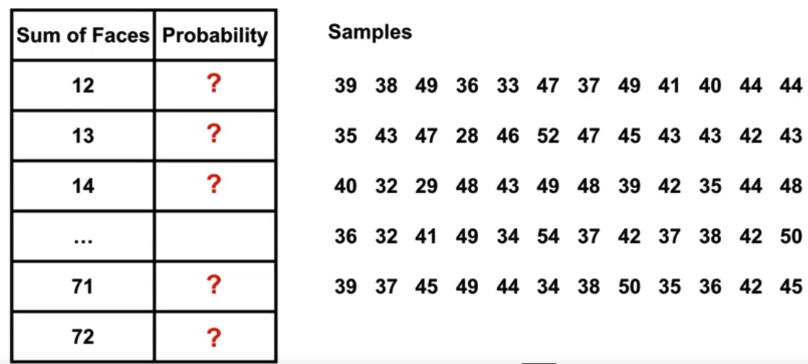
Monte Carlo
Monte Carlo methods estimate values by averaging over a large number of random samples
Example: roll 12 dice a few times and see the result. In this case, the average is 41.57, fairly close to the true average of 42.
Monte- Carlo Methods
4
Notes:
find the average sum of 12 dice rolls
4

Slide 5
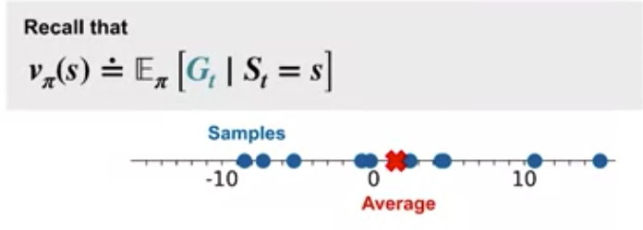
Monte Carlo
Monte Carlo method for learning a value function would first observe multiple returns from the same state.
It average those observed returns to estimate the expected return from that state
Monte- Carlo Methods
5
Notes:
5

Slide 6
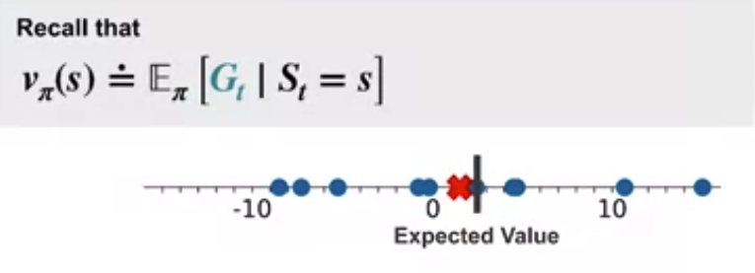
Monte Carlo
The number of samples increases, the average tends to get closer and closer to the expected return.
The more returns the agent observes from a state, the more likely it is that the sample average is close to the state value.
Monte- Carlo Methods
6
Notes:
6

Slide 7
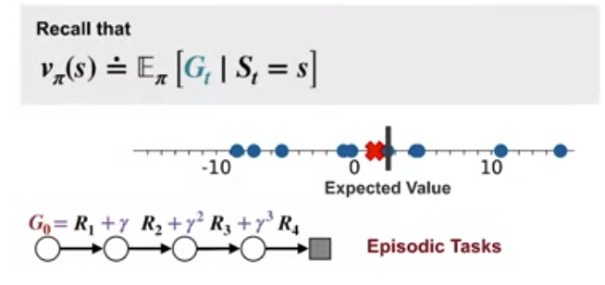
Monte Carlo
These returns can only be observed at the end of an episode
We will focus on Monte Carlo methods for episodic tasks
Monte- Carlo Methods
7
Notes:
7

Slide 8
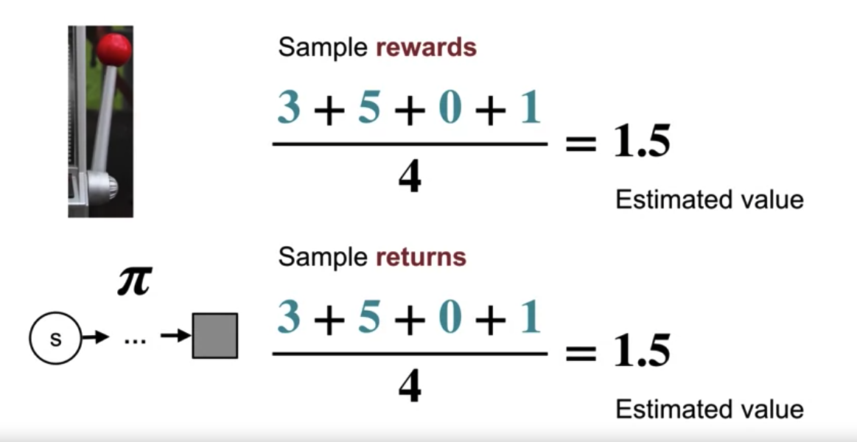
Monte Carlo
In bandits the value of an arm is estimated using the average payoff sampled by pulling that arm.
Monte Carlo methods consider policies instead of arms.
The value state S under a given policy is estimated using the average return sampled by following that policy from S to termination.
Monte- Carlo Methods
8
Notes:
8

Slide 9
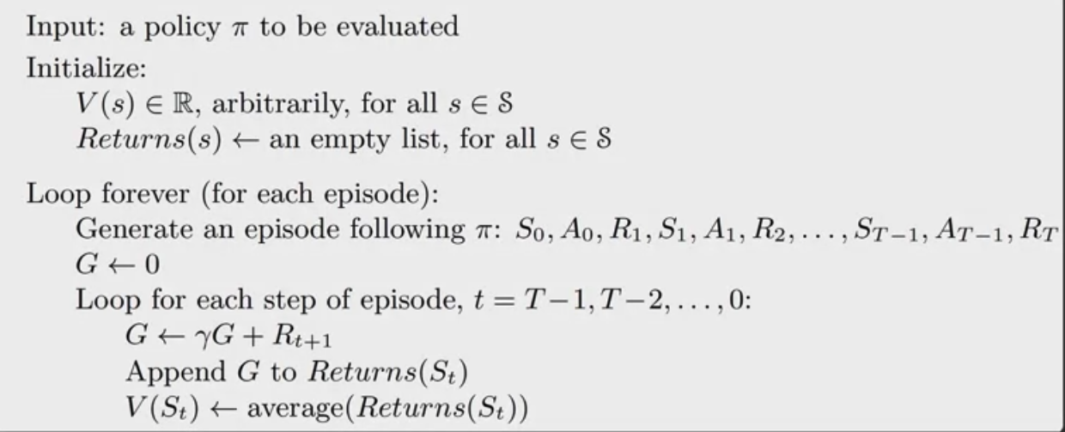
Monte Carlo
Algorithm for estimating the state value function of a policy
Monte- Carlo Methods
9
Notes:
9

Slide 10
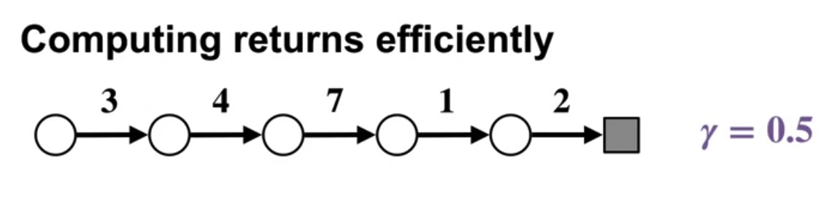
Monte Carlo
Suppose the discount factor is 0.05 and imagine an episode ending at time step five where the reward sequences is 3, 4, 7, 1, and two.
Let's find each return G_0 to G_5, starting by writing down the equation for each return.
Monte- Carlo Methods
10
Notes:
10

Slide 11
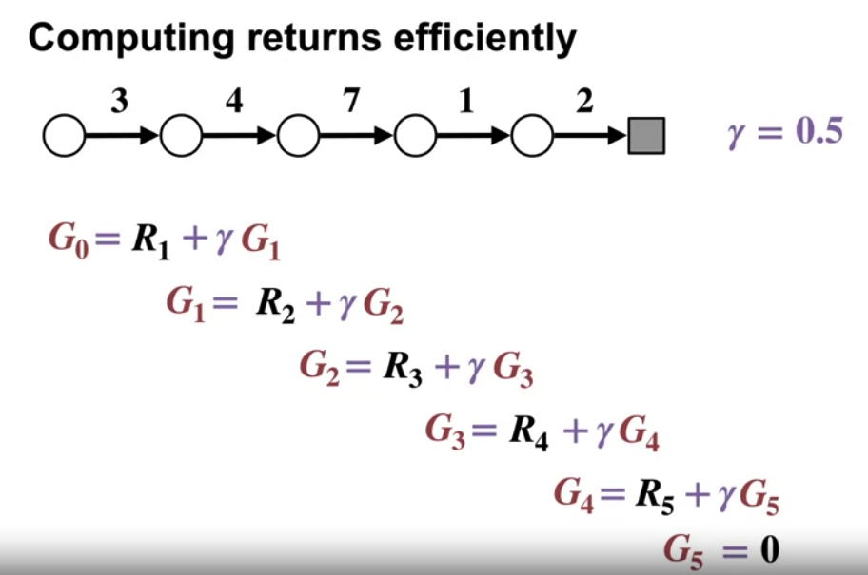
Monte Carlo
Each return is included in the equation for the previous time steps return
Monte- Carlo Methods
11
Notes:
11

Slide 12
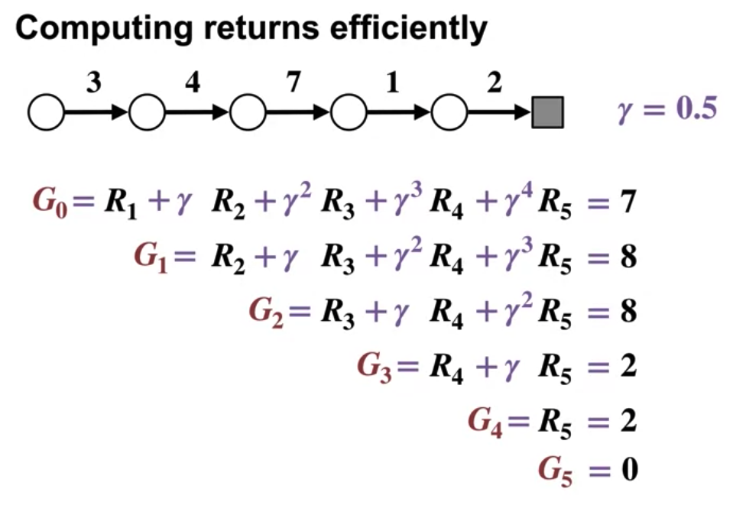
Monte Carlo
The results
Monte- Carlo Methods
12
Notes:
12

Slide 13
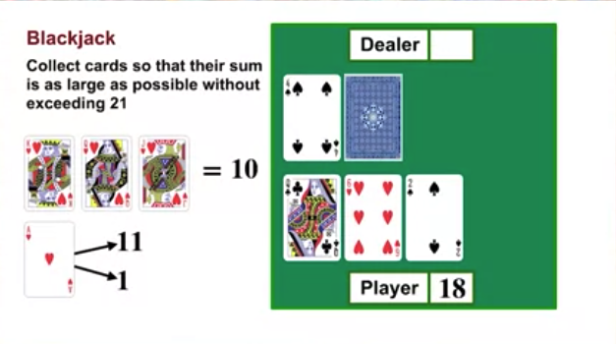
Monte Carlo for Prediction
Example for Blackjack
How to win this game ?
Monte- Carlo Methods
13
Notes:
13

Slide 14
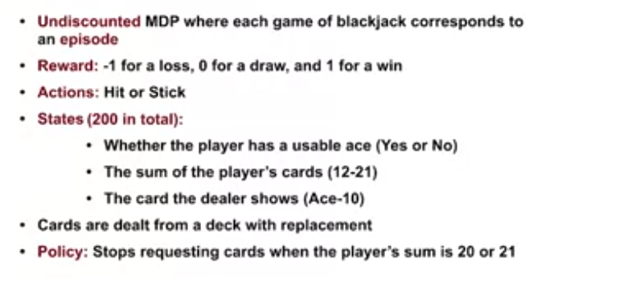
Monte Carlo for Prediction
Problem formulate:
Monte- Carlo Methods
14
Notes:
14

Slide 15
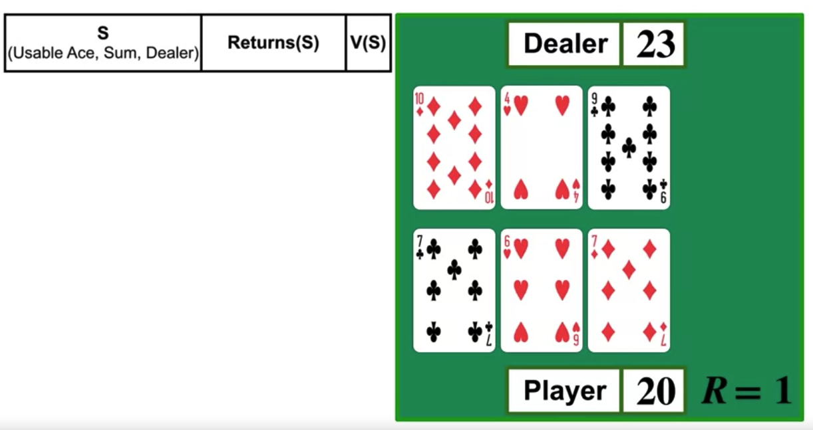
Monte Carlo for Prediction
Suppose in the first state, the agents card shows a total of 13 with no usable ace and the dealers visible card shows 10.
Since the agent's policy is fixed, it hits and gets a 7 moving it to 20.
The agent sticks because its sum is 20 and it's now the dealers turn.
The dealer draws a nine and goes bust losing the game and resulting in plus one reward for the agent.
Monte- Carlo Methods
15
Notes:
15

Slide 16
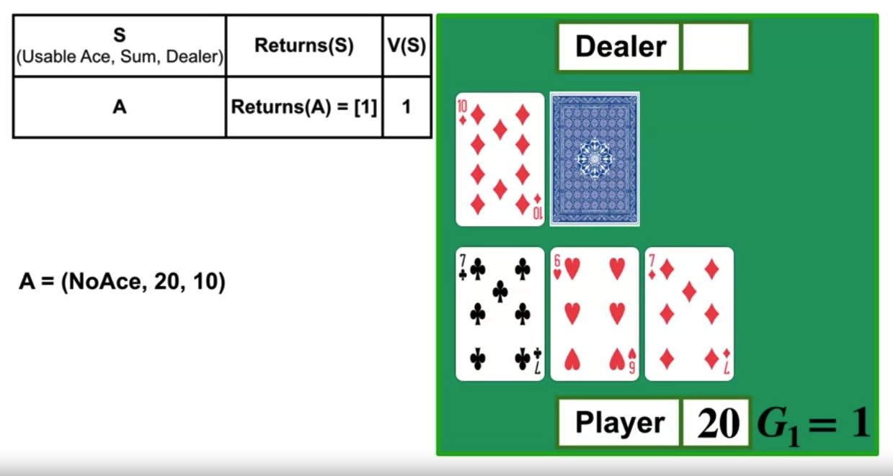
Monte Carlo for Prediction
In the last non-terminal state, the card sum was 20 with no usable ace and the dealer had a visible 10- state A.
We add plus one to the list of returns for state A and set the value of state A equal to the average of the list
Monte- Carlo Methods
16
Notes:
16

Slide 17
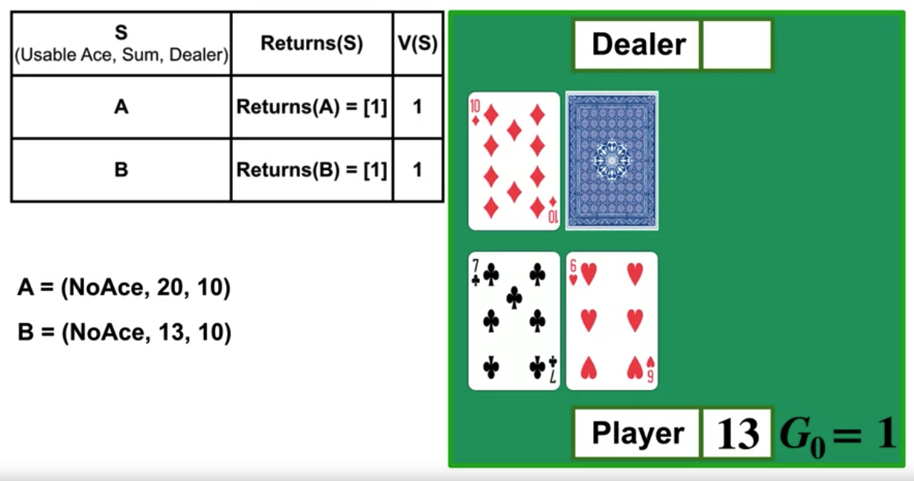
Monte Carlo for Prediction
The second last state, state B, the agent shows 13 with no usable ace and the dealer has a visible 10.
We add plus one to the list of returns now for state B and set the value of state B equal to the average of the list
Monte- Carlo Methods
17
Notes:
17

Slide 18
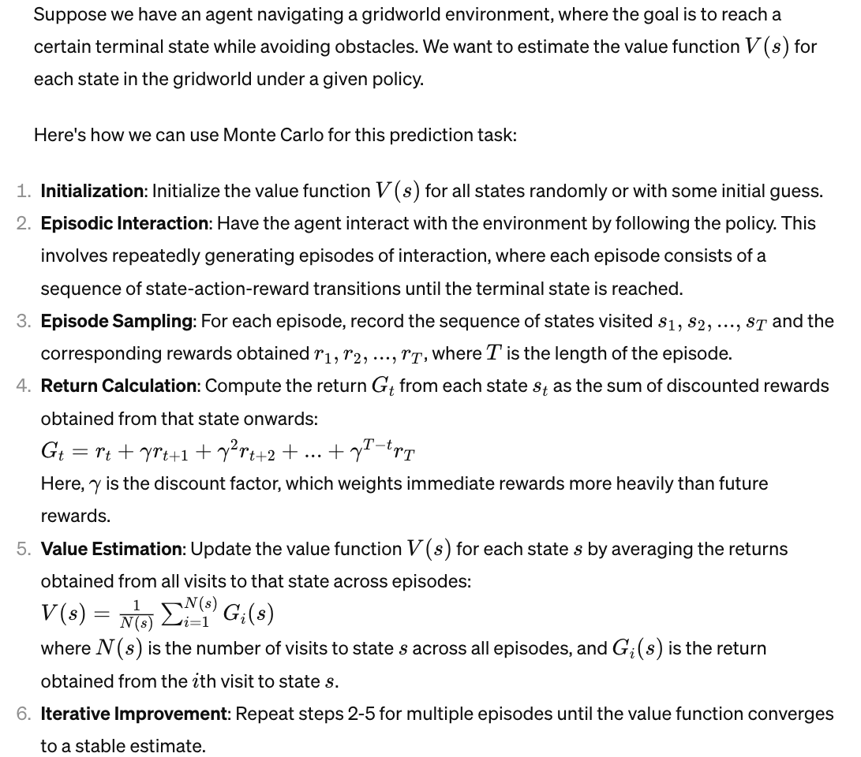
Monte Carlo for Prediction
Example
Monte- Carlo Methods
18
Notes:
18

Slide 19
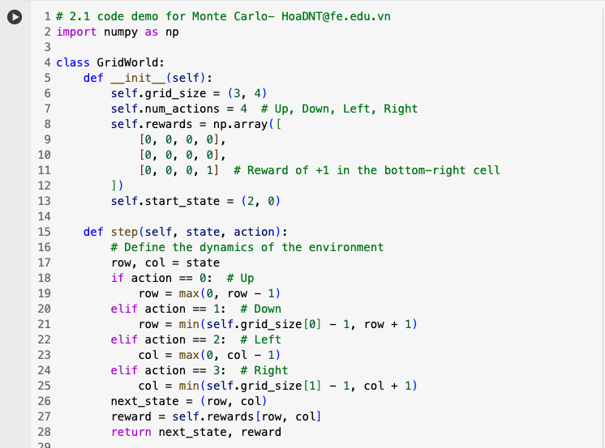
Monte Carlo for Prediction
Monte Carlo to estimate the state-value function for a simple grid world environment.
Monte- Carlo Methods
19
Notes:
19

Slide 20
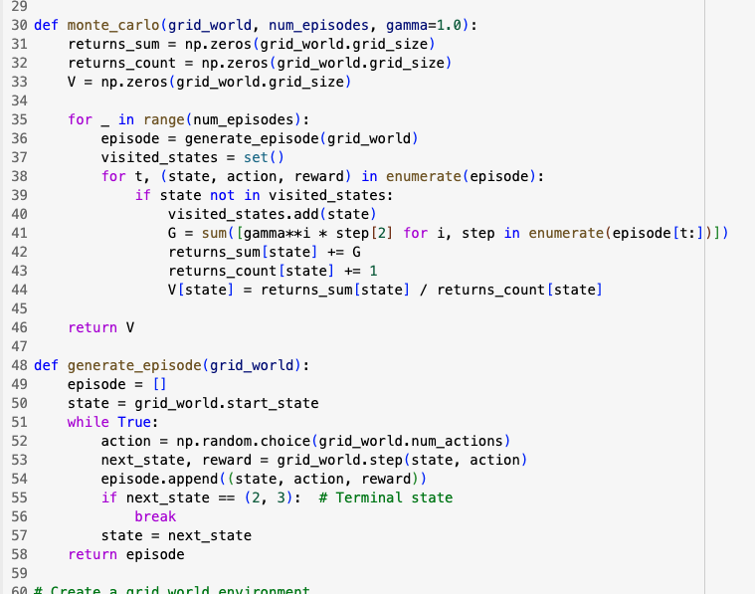
Monte Carlo for Prediction
Monte- Carlo Methods
20
Notes:
20

Slide 21
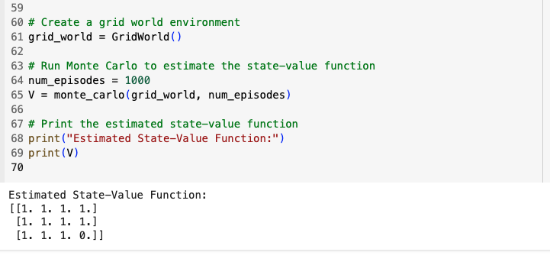
Monte Carlo for Prediction
Monte- Carlo Methods
21
Notes:
21

Slide 22
Summary
Understand how Monte-Carlo methods can be used to estimate value functions from sampled interaction
Identify problems that can be solved using Monte-Carlo methods
Use Monte-Carlo prediction to estimate the value function for a given policy.
Monte- Carlo Methods
22

Slide 23
Q & A
Monte- Carlo Methods
23

